Slide 1

Getting Started Guide for
TU805
Engineering Students
Group B2
Welcome to University Life
This guide is designed to help you settle in for the first two weeks of the term. It will help you organise classes, manage tasks, and capture your progress Use the sections in this booklet to stay on top of your tasks for the first two weeks and make the most of your engineering experience.
Notes:
General cover page with welcome message from programme chair and labelled clearly with class year and group if applicable.
For UDL guidelines, please consider:
Text should be dyslexia friendly (Arial, Comic Sans, Verdana or OpenDyslexic).
Text should be simply written
Emailed versions should be sent as both Powerpoint and PDF to facilitate students to increase text size or use Reader Pens
A podcast version and a video can also be provided in line with UDL guidelines.
PRINTING INSTRUCTIONS:
This page is set up as an A5 so it can be printed and folded into booklet form.
First of all print as a PDF then open Adobe Acrobat and print (So that it can be read as an A5 booklet) – See here: https://helpx.adobe.com/acrobat/kb/print-booklets-acrobat-reader.html

Slide 2
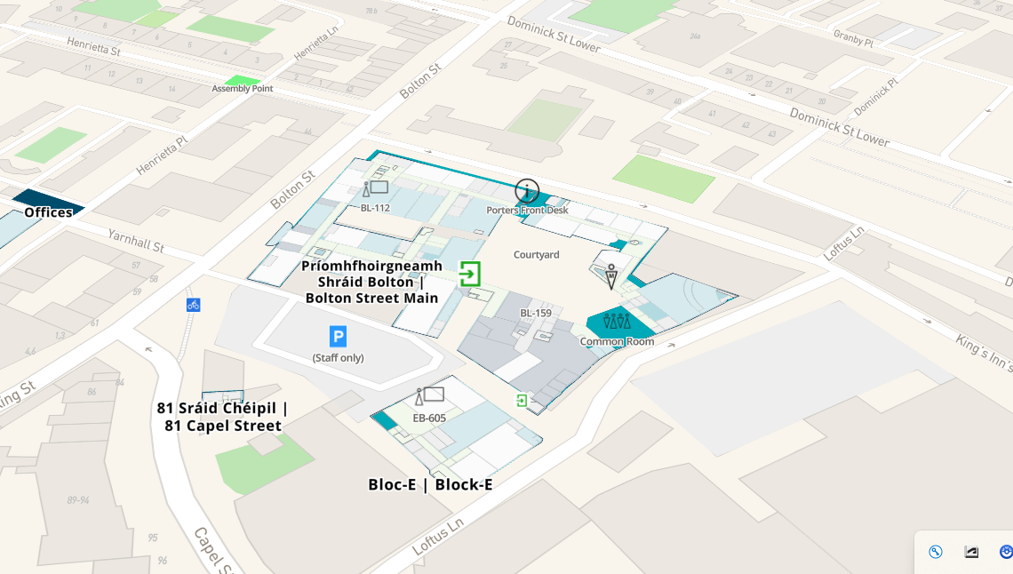
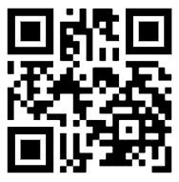
Your classes will take place in the Bolton Street Building and in the Central Quad in Grangegorman.
How to get to Bolton Street
Address: TU Dublin, Bolton Street, D01 K822
Use Maze Map to show directions on how to get to Bolton Street
MazeMap - Bolton Street
On the timetabling system, rooms in Bolton Street are labelled BST
Notes:
The next page or two can include general instructions on how to get to campus and specifically different buildings that the students will be in for the first two weeks.
Be sure to name the buildings specifically.
Provide both links that they can click if receiving the guide by email and QR codes they can scan if viewing the printed version.

Slide 3
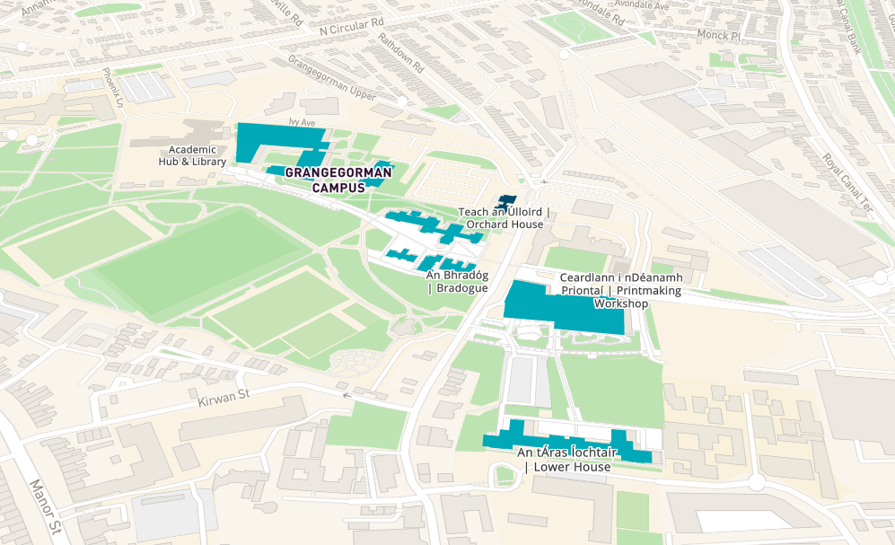
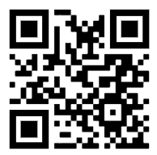
How to get to Grangegorman
Address: TU Dublin, Grangegorman Lower, Dublin 7,
D07 C972
Use Maze Map to show directions on how to get to Grangegorman
MazeMap - Grangegorman
On the timetabling system, rooms in Central Quad, Grangegorman are labelled CQ

Slide 4
Week 1 – To Do List
To Do | By When | Complete
Read the Getting Started guide | Monday 14th Sept 26 | √
Purchase: Lab Coat Safety Glasses Gloves Scale Ruler T Square Pens, Pencils and Erasers | Monday 14th Sept 26
Try to find a locker – bring a padlock | Monday 14th Sept 26
Log into student email | Monday 14th Sept 26
Introduce myself to 5 people | Monday 14th Sept 26
Ask someone to join them for lunch | Monday 14th Sept 26
Introduce myself to another 3 people | Tuesday 15th Sept 26
Find the library | Tuesday 15th Sept 26
Visit the Students Union in Bolton Street | Wed 16th Sept 26
Find Central Quad in Grangegorman | Wed 16th Sept 26
Log into the PUBLISH timetabling system and filter for your Student Set | Wed 16th Sept 26
Complete Registration Process | Friday 18th Sept 26
Check out the Clubs and Societies | Friday 18th Sept 26
Notes:
This first page is a to do list for the first week.
Highlight items hey will need to purchase and key actions they need to take, such as Log onto email, find a locker and register.
Add any items which may help with their social integration such as attend the induction meeting at the residences etc.

Slide 5
Monday – 14th September 2026
Where should I be? – Bolton Street – All Day
Time | Location | Module | Lecturer | Notes for Week 1 and 2
9.00-10.00 | BST 259 | Maths | Mary Johnston
10.00-11.00 | FREE THIS WEEK – Week 1 |  |  | You have a tutorial every second week at this time, so you will have a class in Week 2
11.00-13.00 | BST 491 | Physics Lab | Paul Harding
13.00-14.00 | BST 248 | Maths tutorial | Ahmed Mohammed
14.00-15.00 | Lunch
15.00-17.00 | BST 492 | Chem Lab | Catherine McQuaid | *Don’t forget your lab coat and safety glasses ** No bags allowed in lab (only laptop, pen and notebook)– put them in a locker
What do I need to bring today?
Lab Coat Notepad Pens Pencils
Safety glasses Calculator
A new thing to try today?
Find a locker and put on a padlock
Log onto student email
Introduce myself to 5 people
Ask someone to join them for lunch
Notes:
For each day, create a simple timetable indicating where the student should be, what the module is, the name of the lecturer and what they need to bring.
Keep it simple.
This can either be provided as a page for each day for the first two weeks, or as is the case here, week 1 can be provided with notes about week 2.
This suits particularly when the students are on a week on, week off schedule with lab classes.
Colour coding can be used to indicate free periods and lunch, and as this is a table, cells can be added, merged etc to align with length of each session.
Add a checklist of what to bring and a new thing to try each day.

Slide 6
Tuesday – 15th September 2026
Where should I be? – Bolton Street – All Day
Time | Location | Module | Lecturer | Notes for Week 1 and 2
9.00-11.00 | BST 390 | Engineering Computing | Eileen Tanaka
11.00-12.00 | FREE PERIOD EVERY WEEK
12.00-13.00 | FREE PERIOD EVERY WEEK
13.00-14.00 | Lunch
14.00-15.00 | BST 259 | Chemistry Lecture | Catherine McQuaid
15.00-16.00 | BST 259 | Physics Lecture | Gerry Murphy
What do I need to bring today?
Notepad Pens Pencils
Calculator
A new thing to try today?
Find the library and borrow a book
Suggest to some of your group members after computing class to go out for a walk and have a look around the Ilac Centre for somewhere good to have lunch
Notes:
For each day, create a simple timetable indicating where the student should be, what the module is, the name of the lecturer and what they need to bring.
Keep it simple.
This can either be provided as a page for each day for the first two weeks, or as is the case here, week 1 can be provided with notes about week 2.
This suits particularly when the students are on a week on, week off schedule with lab classes.
Colour coding can be used to indicate free periods and lunch, and as this is a table, cells can be added, merged etc to align with length of each session.
Add a checklist of what to bring and a new thing to try each day.

Slide 7
Wednesday – 16th September 2026
Where should I be? – Bolton Street in am, Grangegorman in pm
Time | Location | Module | Lecturer | Notes for Week 1 and 2
9.00-11.00 | BST 259 | Electrotechnology | Aidan O Neill
11.00-12.00 | BST 259 | Maths | Mary Johnston
12.00-13.00 | Lunch - Have your lunch in Bolton Street (BST) at this time as you will need to walk up to Grangegorman for 2pm. It takes about 15 mins to walk to Grangegorman
14.00-16.00 | CQ 344 | Electro Tech Lab | Jane Connolly | This is on 3rd floor in Central Quad, GG *Don’t forget your lab coat and safety glasses ** No bags allowed in lab (only laptop, pen and notebook)– put them in a locker
What do I need to bring?
Lab Coat Notepad Pens Pencils
Safety glasses Calculator
A new thing to try today?
Find a new room (344) in Central Quad in Grangegorman
Introduce yourself to 3 people in your lab group in Electrotechnology
Ask someone to walk up to Grangegorman with you after lunch
Notes:
For each day, create a simple timetable indicating where the student should be, what the module is, the name of the lecturer and what they need to bring.
Keep it simple.
This can either be provided as a page for each day for the first two weeks, or as is the case here, week 1 can be provided with notes about week 2.
This suits particularly when the students are on a week on, week off schedule with lab classes.
Colour coding can be used to indicate free periods and lunch, and as this is a table, cells can be added, merged etc to align with length of each session.
Add a checklist of what to bring and a new thing to try each day.

Slide 8
Thursday – 17th September 2026
Where should I be? – Grangegorman all day
Time | Location | Module | Lecturer | Notes for Week 1 and 2
9.00-11.00 | CQ 006 | Electrotech Lecture | Aidan O Neill
11.00-12.00 | FREE PERIOD EVERY WEEK
12.00-13.00 | FREE PERIOD EVERY WEEK
13.00-14.00 | Lunch
14.00-16.00 | CG 338 | Technical Graphics Lab | Gerry Murphy | Bring your T Square, Scale rule, pencils, eraser shield This lab will be every other week, so next week you will be free at this time.
What do I need to bring?
T-Square Scale Ruler, Drawing pencils Erasers
Notepad Pens Pencils Calculator
A new thing to try today?
Have a walk around the Academic Hub in Grangegorman
Find the Students Services Desk in Rathdown House
Check your TU Dublin email and install it on your phone.
Notes:
For each day, create a simple timetable indicating where the student should be, what the module is, the name of the lecturer and what they need to bring.
Keep it simple.
This can either be provided as a page for each day for the first two weeks, or as is the case here, week 1 can be provided with notes about week 2.
This suits particularly when the students are on a week on, week off schedule with lab classes.
Colour coding can be used to indicate free periods and lunch, and as this is a table, cells can be added, merged etc to align with length of each session.
Add a checklist of what to bring and a new thing to try each day.

Slide 9
Friday – 18th September 2026
Where should I be? – Bolton Street all day
Time | Location | Module | Lecturer | Notes for Week 1 and 2
9.00-11.00 | BST 259 | Physics | Ahmed Mohammed
11.00-12.00 | BST 259 | Maths | Mary Johnston
12.00-13.30 | Lunch
13.30-17.30 | BST 424 | Design Project | Micheal O’Brien
What do I need to bring?
Notepad Pens Pencils
Calculator
A new thing to try today?
You will be in a new group in Design Project – make sure to introduce yourself to your teammates
Swap contact details / et up a What’s App with your team mates to allow you to work on the project during the week.
Notes:
For each day, create a simple timetable indicating where the student should be, what the module is, the name of the lecturer and what they need to bring.
Keep it simple.
This can either be provided as a page for each day for the first two weeks, or as is the case here, week 1 can be provided with notes about week 2.
This suits particularly when the students are on a week on, week off schedule with lab classes.
Colour coding can be used to indicate free periods and lunch, and as this is a table, cells can be added, merged etc to align with length of each session.
Add a checklist of what to bring and a new thing to try each day.

Slide 10
First Year Contact Details
Head of Discipline: caoimhe.surname@tudublin.ie
Programme Chair: kevin.surname@tudublin.ie
Year Tutor: mary.surname@tudublin.ie
Each lecturer usually has an email address of
firstname.surname@tudublin.ie
What do I do if:
I’m sick for one day and missing a lecture/tutorial.
Usually if you are sick just for one day and miss a lecture you will be able to catch up. So just get better and we will see you the next day.
I’m sick for one day and missing a lab.
It is very important that you let us know if you are going to miss a lab if you are sick because we will need to try to rearrange a catch up lab for you. In this case, please contact your Head of Discipline and the lab lecturer to let them know you are sick and complete an EC form here: EC FORM
I’m sick for a few days.
In this case, please do let us know by emailing your Head of Discipline and submitting an EC form here: EC FORM
We also wish you a speedy recovery!
Notes:
On the final page you can add contact details of the key staff they meet in the first two weeks and very simple “what to do if”, but this page should not be overwhelmed with information.

