Slide 1

Innovative interventions
to improve integration
of STEM university students​
Erasmus+ Project 2024 - 2027
Notes:
These notes were prepared by the In-4-STEM Erasmus+ project. Feel free to use these as a template for your workshop. If you require any additional information on the project please contact carolien.vansoom@kuleuven.be.

Slide 2
Please feel free to use these slides to support the Bounce Back: Smarter Study Strategies Workshops
All three weeks are included in this pack:
  Week 1: Time Management
  Week 2: Effective Studying – Note Taking
  Week 3: Exam Techniques

Slide 3
Week 1: Time Management
Duration: 45 minutes
Learning Outcomes:
Understand the importance of time management at university.
Learn about two techniques: Time Blocking and Pomodoro Technique.
Practice creating a personalised time management plan.

Slide 4
0-5mins - Discussion
What’s your biggest challenge when managing time at university?
How do you currently plan your week?
Notes:
Ask the students to take 5 minutes to discuss amongst themselves these two questions.
The aim is to help them see that other students may have similar challenges.

Slide 5
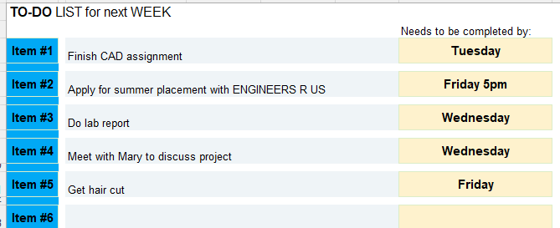
5-10mins – To do list
Putting it on paper gets it out of your head.
Task:
Using the template write your to do list for the next week.
Example:
Notes:
This is a 5 minute task where students are asked to write their to do list for the next week.
Due to time constraints, you can give them a handout - template provided.
However you can mention other ways in which they can keep to do lists, such as using online apps
Todoist
Notion
Remember The Milk
Microsoft To Do
They won’t have time to download it in the session.

Slide 6
10-20mins – Time Blocking Explanation
Now you have a list of to dos.
But how do you plan and prioritise?
Time Blocking
Pros:
Focus on 1 thing at a time
Reduces overwhelm
Gets things done – no more procrastination
Helps prioritise tasks
Record of commitments
Notes:
Use the notes below to explain Time Blocking:
These were taken from: https://unireadytoolkit.com.au/study-smart/
Which also has useful resources.
What is time blocking?
Time blocking means blocking out time across the week for the things you know you need to spend time on.
The pros
It helps to focus on one thing at a time, which makes you more productive and feel less overwhelmed.
It helps with procrastination – no more putting that assessment off!
It ensures important tasks are given the time they deserve (in other words, a great way to prioritise)
How does it work?
Start with the non-negotiables: Each week starts with a schedule with your weekly commitments mapped out, like classes, work and family dinners. Add in anything you’ve already got planned for the week, like movies with friends on Tuesday night.
Deadlines and priorities: Add in any uni deadlines you have for the week and what uni work you need to get done (e.g. Finish draft intro for PSYC1001 report, Submit CHEM1101 quiz by Friday midnight)
Block time: With your deadlines and priorities in mind, block out the time you have available for study for specific tasks (eg Readings for LAWS1203, Working on the draft intro for PSYC1001 report). Time blocks can be short or long, depending on the task.
Minimise distractions: During each time block, focus just on the designated task. Minimise distractions and interruptions as much as possible.
Transition time: Allow for short breaks or transition periods between time blocks to rest, refocus, or switch gears if necessary.
Mix it up: While time blocking provides structure, you need flexibility too. Unplanned responsibilities will come up that you’ll need to prioritise and sometimes you won’t be in the right headspace for what you’ve planned.
Build in breaks: Be realistic. We all need proper breaks when we are studying. Go for a walk, eat something, watch one episode.
Reflect: At the end of the day or week, review how well you adhered to your time blocks and adjust your scheduling and priorities if needed for future planning.

Slide 7
10-20mins – Time Blocking Explanation cont.
How?
Start with the non-negotiables (Class, work, eat, sleep, exercise)
Deadlines and priorities (Finish lab report, submit assignment)
Block time: Block out the time you have available for study for specific tasks
Minimise distractions: In each time block, focus just on the designated task. e.
Transition time: Allow for short breaks or transition periods
Mix it up: While time blocking provides structure, you need flexibility too.
Build in breaks: Be realistic. We all need proper breaks when we are studying. Go for a walk, eat something, watch one episode.
Reflect: Review how well you adhered to your plan. What should you change?
From: https://unireadytoolkit.com.au/study-smart/
Notes:
Use the notes below to explain Time Blocking:
These were taken from: https://unireadytoolkit.com.au/study-smart/
Which also has useful resources.
What is time blocking?
Time blocking means blocking out time across the week for the things you know you need to spend time on.
The pros
It helps to focus on one thing at a time, which makes you more productive and feel less overwhelmed.
It helps with procrastination – no more putting that assessment off!
It ensures important tasks are given the time they deserve (in other words, a great way to prioritise)
How does it work?
Start with the non-negotiables: Each week starts with a schedule with your weekly commitments mapped out, like classes, work and family dinners. Add in anything you’ve already got planned for the week, like movies with friends on Tuesday night.
Deadlines and priorities: Add in any uni deadlines you have for the week and what uni work you need to get done (e.g. Finish draft intro for PSYC1001 report, Submit CHEM1101 quiz by Friday midnight)
Block time: With your deadlines and priorities in mind, block out the time you have available for study for specific tasks (eg Readings for LAWS1203, Working on the draft intro for PSYC1001 report). Time blocks can be short or long, depending on the task.
Minimise distractions: During each time block, focus just on the designated task. Minimise distractions and interruptions as much as possible.
Transition time: Allow for short breaks or transition periods between time blocks to rest, refocus, or switch gears if necessary.
Mix it up: While time blocking provides structure, you need flexibility too. Unplanned responsibilities will come up that you’ll need to prioritise and sometimes you won’t be in the right headspace for what you’ve planned.
Build in breaks: Be realistic. We all need proper breaks when we are studying. Go for a walk, eat something, watch one episode.
Reflect: At the end of the day or week, review how well you adhered to your time blocks and adjust your scheduling and priorities if needed for future planning.

Slide 8
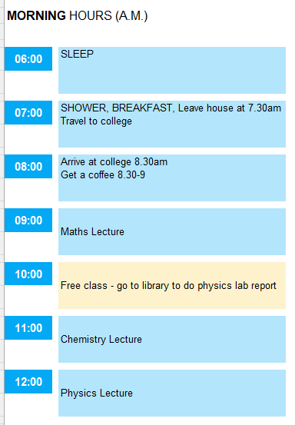
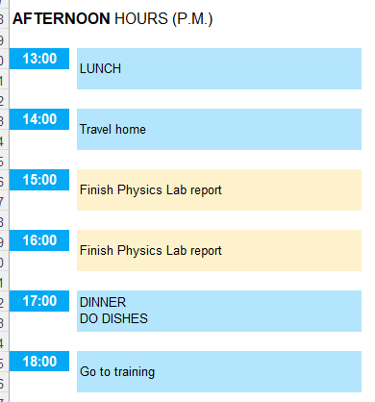
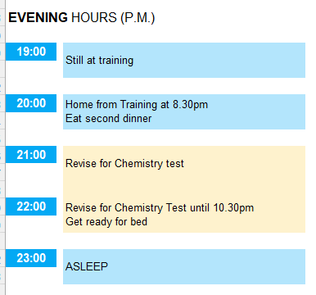
20-35mins – Time Blocking Task
Example
Notes:
If helpful, you can show them this slide to show what it looks like before rets the students to use the templates to put in their to do list and do the time blocking task

Slide 9
20-35mins – Time Blocking Task
Task
Using the template provided, time block your time for 2 days, preferably one during the week and one at weekend.
Use this method:
Start with the non-negotiables (Class, work, eat, sleep, exercise)
Deadlines and priorities (Finish lab report, submit assignment)
Block time: Block out the time you have available for study for specific tasks
Minimise distractions: In each time block, focus just on the designated task. e.
Transition time: Allow for short breaks or transition periods
Mix it up: While time blocking provides structure, you need flexibility too.
Build in breaks: Be realistic. We all need proper breaks when we are studying. Go for a walk, eat something, watch one episode.
From: https://unireadytoolkit.com.au/study-smart/
Notes:
As the students to use the templates to put in their to do list and do the time blocking task

Slide 10
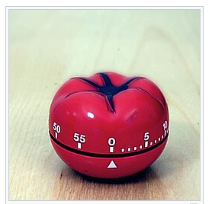
35-40mins – Explanation of Pomodoro Technique
Pomodoro
Work in 25-minute intervals followed by a 5-minute break.
After four rounds, you then take an extended break.
The pros
Improves productivity by structuring your work and scheduling regular breaks
Useful for work that requires focus
Pro tip: Get rid of all distractions in your workspace so you can work uninterrupted for each 25-minute block. On your breaks, get up from your desk and move your body.
https://www.youtube.com/shorts/Sp7mpyV5ohs
https://www.youtube.com/watch?v=QACB1z6I8LQ
Task: Add a red star / circle to those events on your Time Block when you will use Pomodoro
Notes:
You can either explain the Pomodoro technique yourself or break it up using a video = there are some examples on the slide, but you may be able to find more on You Tube.

Slide 11
40-45mins – Reflection and Wrap Up
What lessons did you learn from the tasks today?
What are you likely to use in the future?
Notes:
You can either explain the Pomodoro technique yourself or break it up using a video = there are some examples on the slide, but you may be able to find more on You Tube.

Slide 12
Week 2: Effective Studying - Notetaking
Duration: 45 minutes
Learning Outcomes:
Identify the strengths and limitations of different note‑taking methods
Apply a note taking method to a short task.
Reflect on which method(s) best support their own learning style.

Slide 13
0-10mins – Warm Up – Recall Challenge
Task:
Listen to the following audio clip and afterwards - write down everything you remember.
https://www.bbc.co.uk/learningenglish/english/features/6-minute-english/ep-200326
Compare what you remember with your neighbour
Discuss:
What made recall difficult?
How would note taking help?
Notes:
https://www.bbc.co.uk/learningenglish/features/6-minute-english/
There are lot of audio clips on this podcast series and the first 1 minute introduction can be used for his exercise.
Play the audio clip – students are not allowed to take notes
Then they have 1min to write down everything they remember.
Then discuss what they found difficult and what would help.

Slide 14
10-20mins – Note taking Methods
Short introduction to:
Cornell Method
Outline Method
Boxing Method
Charting Method
Mapping Method
All resources from: https://unireadytoolkit.com.au/study-smart/
Notes:
On this slide you will explain that you are going to give them a short introduction to each method and then they to need to think about which they would like to use in the exercise which follows.

Slide 15
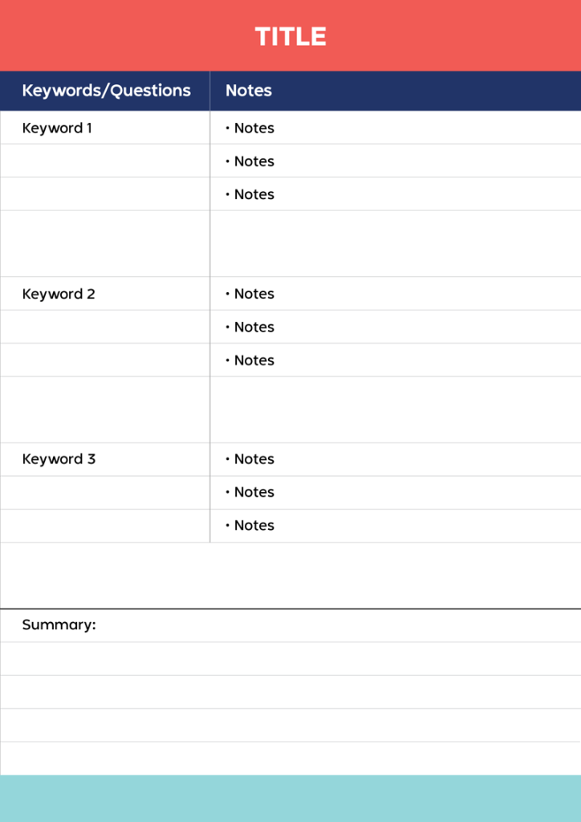
10-20mins – Note taking Methods
Cornell Method
The pros
Great for summarising and reviewing content.
Encourages deep engagement with the content.
Ideal for structured review of notes before exams.
Keep in mind
You may write and rewrite your Cornell notes, as you become more confident with the content.
Best for
Structured review of content before exams
Highlighting key ideas in a lecture
All resources from: https://unireadytoolkit.com.au/study-smart/
Notes:
Using the notes from https://unireadytoolkit.com.au/study-smart/, you can summarise each method

Slide 16
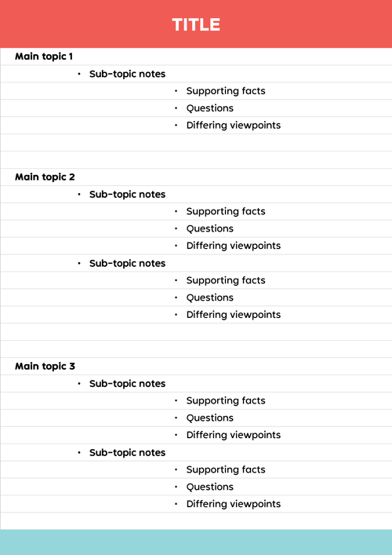
10-20mins – Note taking Methods
Outline Method
The pros
It’s simple, quick and effective for organising ideas.
Keep in mind
The simplicity of the Outline Method may mean it’s harder to capture more nuanced information.
It’s text-heavy, so may be less useful where visual information is required.
Best for
Great for note-taking during lectures or when reading before class.
Subjects with well-structured and hierarchical content.
All resources from: https://unireadytoolkit.com.au/study-smart/
Notes:
Using the notes from https://unireadytoolkit.com.au/study-smart/, you can summarise each method

Slide 17
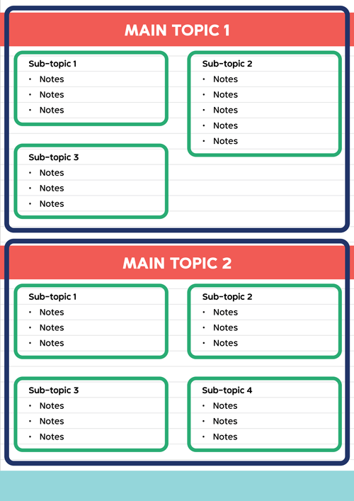
10-20mins – Note taking Methods
Boxing Method
The pros
• Clearly organises information visually into boxes.
• Encourages clear and concise notes (to fit into boxes!), which means better topic understanding.
Keep in mind
• Can be time-consuming.
Best for
• Note-taking on topics you’re already familiar with.
• When you want a visual but flexible organisation for notes.
• Getting clear on a topic and discovering what areas you don’t understand so well.
All resources from: https://unireadytoolkit.com.au/study-smart/
Notes:
Using the notes from https://unireadytoolkit.com.au/study-smart/, you can summarise each method

Slide 18
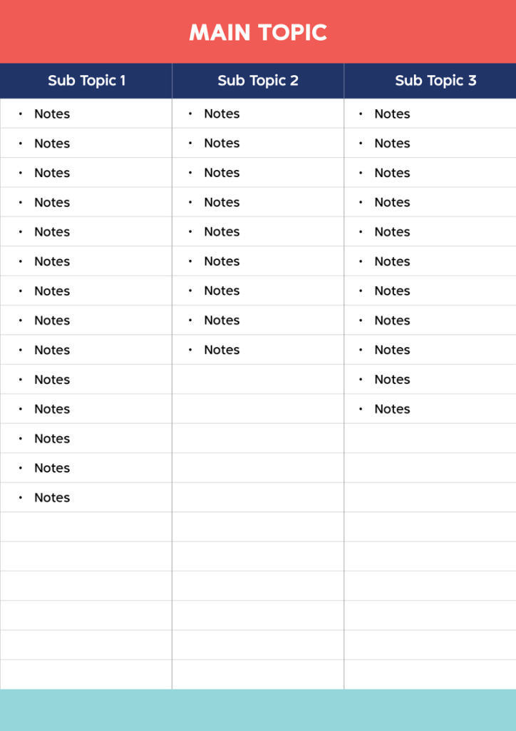
10-20mins – Note taking Methods
Charting Method
The pros
• Offers a great structure for understanding data-driven content.
Keep in mind
• It may not be useful for text-heavy topics or where the information is difficult to categorise.
Best for
• Practicing recall for quizzes or exams, especially for reviewing numerical information and statistics.
All resources from: https://unireadytoolkit.com.au/study-smart/
Notes:
Using the notes from https://unireadytoolkit.com.au/study-smart/, you can summarise each method

Slide 19
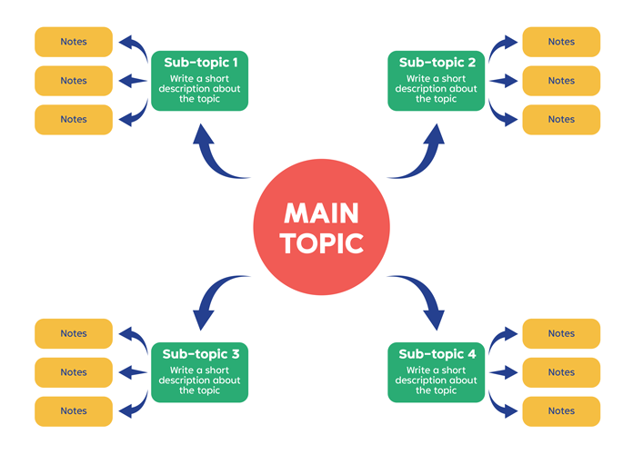
10-20mins – Note taking Methods
Mapping Method
The Pros
Encourages creative representation of information, inc concepts.
• Represents the relationships between pieces of information.
Keep in mind
• It’s not well suited to note-taking for subjects where you need to remember lots of detail.
Best for
• Learning complex or abstract concepts.
• Understanding the big-picture themes or ideas in your subjects.
• Mapping out plans for assessments like essays, reports or presentations
All resources from: https://unireadytoolkit.com.au/study-smart/
Notes:
Using the notes from https://unireadytoolkit.com.au/study-smart/, you can summarise each method

Slide 20
20-30mins – Note taking - Task
Choose a note taking method
Either watch the video or use an example text to make notes on a topic.
https://www.youtube.com/watch?v=1wHT-dq7SG0
All resources from: https://unireadytoolkit.com.au/study-smart/
Notes:
Using the notes from https://unireadytoolkit.com.au/study-smart/, you can summarise each method
This example is a video about computers from You Tube – but any detailed video will suffice
You should have printouts of each template to provide to students so they can select the most appropriate.

Slide 21
30-35mins – Note taking - Discussion
Discuss with your partner
  What was useful about your method?
  Was it best suited to the task?
  What would you do differently next time?
All resources from: https://unireadytoolkit.com.au/study-smart/
Notes:
Using the notes from https://unireadytoolkit.com.au/study-smart/, you can summarise each method
This example is a video about computers from You Tube – but any detailed video will suffice

Slide 22
35-45mins – Wrap Up
What lessons did you learn from the tasks today?
What are you likely to use in the future?
Notes:
This allows students to discuss the different methods and feed back future actions.
They may also recognise that now that they know what the video was about, they may use a different method next time.
Eg, Mapping instead of Cornell Method,
Also circulate feedback questionnaire.

Slide 23
Week 3: Exam Technique
Duration: 45 minutes
Learning Outcomes:
Identify common university assessment types
Apply time‑management techniques to sample exam papers.
Reflect on the types of action verbs used in exam questions

Slide 24
0-10mins – Warm Up – Exam Memories
Task:
Discuss with your neighbour
Semester 1 exams
  What went well?
  What did not?
  How did they compare to the leaving certificate exams
Notes:
To activate their concerns about exams, get them talking about previous exam scenarios, semester 1 exams if this is being delivered in semester 2 or their high school certificate (Leaving certificate in Ireland, which is very high pressure)

Slide 25
10-15mins – Identifying types of assessments
What are the different types of assessments you have in your course?
Written Exam (end of year)
Class Test
Essay Assignment
Project Report
Lab Report
Presentation
Drawing submission
Notes:
Ask students to call out the different type of exams (or exams and CA) they have in their course – write these on the board.
Reveal the assessments you are aware of.
Explain that each one has different requirements and thus study techniques, but this session will focus on exams.

Slide 26
15-25 mins – Reading exam papers practice
Using the provided exam paper, undertake two tasks
Identify the time that should be taken for each question
Underline the key tasks for each question
Notes:
Provide the students with an example exam paper which you have reviewed within their area of expertise (or ask them to bring an exam paper with them)
Ask them to calculate the time for each question and write it on the paper and then write down ( or underline) what the question is actually asking.

Slide 27
25-35 mins – Understanding verbs
  List = List
  Draw = draw with detail
  Sketch = Draw by hand
  Identify = simple recall
  Explain = cause/effect or process
  Compare/contrast = similarities + differences
  Analyse = break into parts, show relationships
  Evaluate = make a judgement with reasons
Notes:
Spend 5 minutes then going over the answers.,, ie what do verbs such as define, describe, explain, compare, analyse, evaluate, list. in terms of how they approach the answer.

Slide 28
35-40 mins – Pro tips for exam practice
Start revising early!
Listen to lecturers about the exam. Your lecturers write the exams! If your lectures emphasise a particular topic throughout the course, they will probably think it’s important and include it in the exam.
Practice recall. Most exams are about remembering key information when you’re in the exam.
Write yourself questions when you study and then close your books and practice answering your questions without your notes.
Manage your study time across different subjects. Your exams will all be scheduled in a two-week period at the end of the term/semester.
Do past papers.
Notes:
Finish up with some tips

Slide 29
40-45 mins – Actions from today
What lessons did you learn from the tasks today?
What are you likely to use in the future?
Notes:
Finish up with some reflection and ask them to complete the feedback questionnaire.

