Slide 1

Vision, Goals and Growth​
Erasmus+ Project 2024 - 2027
Notes:
12.15 – 12.25 Carolien intro
12.25- 12.30 Cindy Step 1 inventory
12.30-12.35 Una Step 2 design
12.35 – 12.55 Break-out room
12.55-13.10: report from BO rooms
13.10-13.20 Lynn Step 3 implementation
+ poll/word cloud
13.20- 13.30 Esther Step 4 dissemination
+ small acitivity on dissemination?
13.30 – 13.32 Carolien wrap up timeline
13.32-13.45 feedback, discussion…

Slide 2
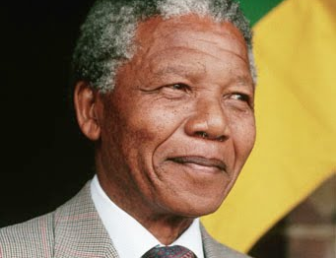
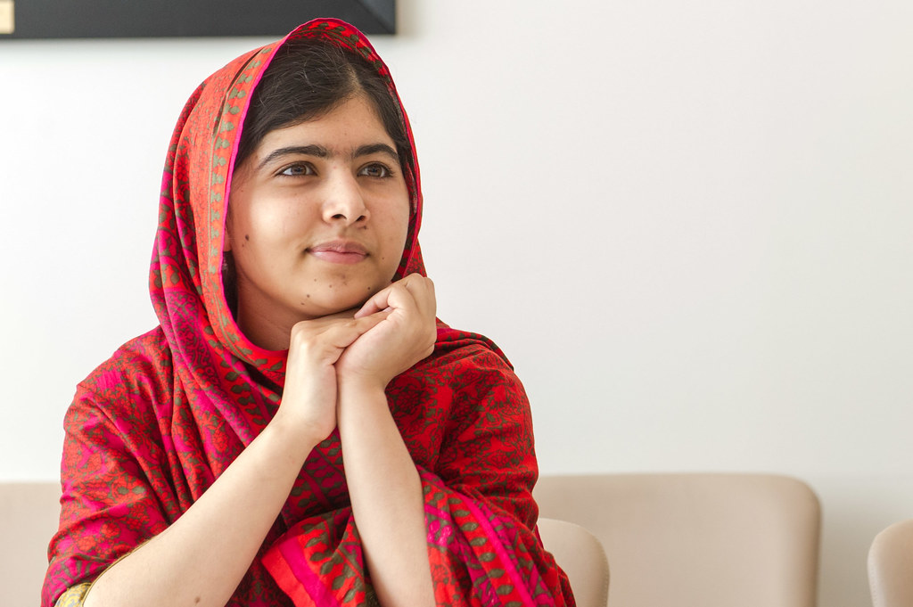
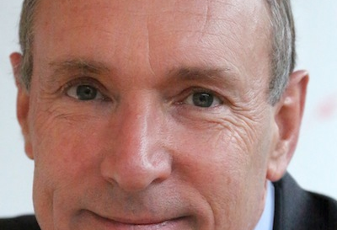
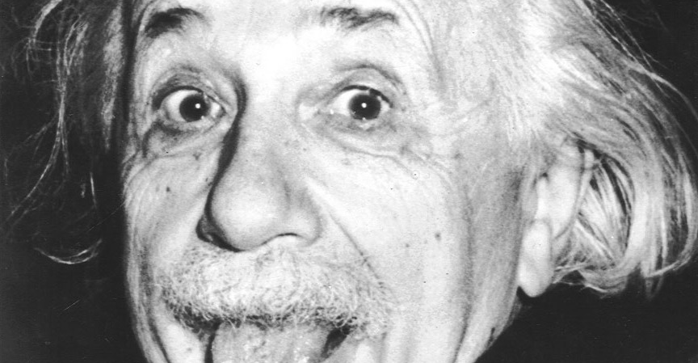
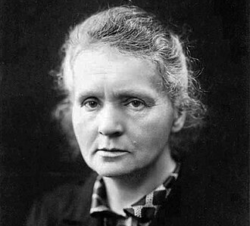
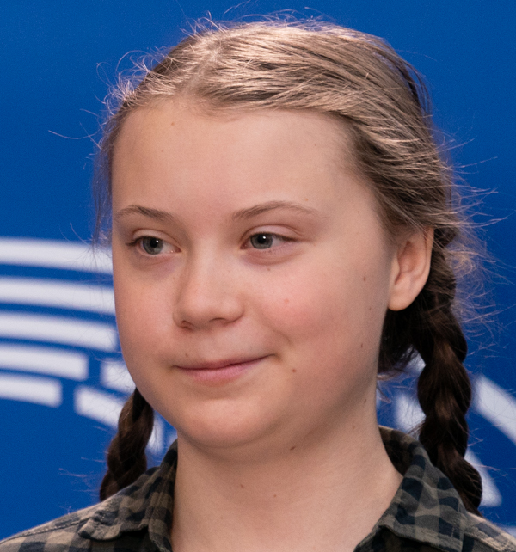
People who have changed the world
Nelson Mandela – Fought apartheid in South Africa
Malala Yousafzai – Education for girls activist. Youngest Nobel prize laureate
Tim Berners Lee – Inventor of the world wide web
Albert Einstein – Theory of Relativity
Marie Sklodowska Curie – 2 nobel prizes in 2 sciences
Greta Thunberg - Climate change activist
  Who has changed your world?
This Photo b Unknown Author is licensed under CC BY-NC-ND
This Photo by Unknown Author is licensed under CC BY-NC-ND
This Photo by Unknown Author is licensed under CC BY-SA
This Photo by Unknown Author is licensed under CC BY-NC
This Photo by Unknown Author is licensed under CC BY-NC-ND
This Photo by Unknown Author is licensed under CC BY-SA
Notes:
The photos and names could be revealed using animation and asking students to identify them before revealing the names.
Use https://www.mentimeter.com/ to get them to identify their examples of people who have changed the world.

Slide 3
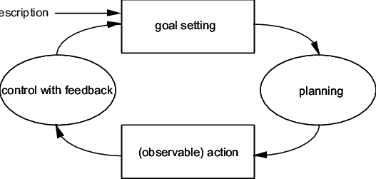
Proactivity Orientation Program (POP)
Training for first year students around goal setting and reflection.
Based on Action Regulation Theory
https://www.researchgate.net/figure/A-complete-activity-cycle-in-action-regulation-theory_fig1_2278655
Robbins, S. B., Lauver, K., Le, H., Davis, D., Langley, R., & Carlstrom, A. (2004). Do Psychosocial and Study Skill Factors Predict College Outcomes? A Meta-Analysis. Psychological Bulletin, 130(2), 261–288. https://doi.org/10.1037/0033-2909.130.2.261

Slide 4
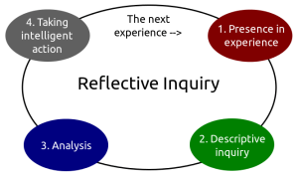
Reflection
Pay attention to your practice so that it can be improved in an iterative way.
This Photo by Unknown Author is licensed under CC BY-SA-NC

Slide 5

Record your thoughts using these prompts
This is for you. It will not be seen by anyone else unless you choose to share it.
Write or Record your voice as preferred
my ideal future
qualities I admire in others
things I could do better
my university and career future
things I would like to learn more about
habits I would like to improve (i.e., related to school,
work, relationships, health)
This Photo by Unknown Author is licensed under CC BY-NC
Notes:
Set time depending on time available
Voice recording may not be practical in short time frame.

Slide 6
Based on the free writing exercise, establish what my desired future is
Establish a number (6-8) clear and specific goals from the free writing which could be used to achieve the desired future.
e.g. Desired future: Win an Olympic medal
Clear and Specific goal:
Devise a healthy eating plan
Find out what sports options are in the Olympics
Start practising that sport
Notes:
The example goal is far fetched and therefore would not impact their independent thoughts

Slide 7

For each goal​
rank its order of importance
Find out what sports options are in the Olympics
Start practising that sport
Devise a healthy eating plan
(b) give specific reasons why the goal is important for achieving the desired future
Find out what sports options are in the Olympics: You need to know what the possibilities are to have any chance
(c) evaluate the attainability within a self-specified time frame
Find out what sports options are in the Olympics: Totally possible to figure this out before the end of today using google.
This Photo by Unknown Author is licensed under CC BY

Slide 8
What impact would achieving each goal have on specific aspects of my life and the lives of others (specific others, if you choose)
e.g. If I have to train for the Olympics, it will limit the time I have to spend with family and friends
Family and friends can attend the Olympic games and support me.

Slide 9
Determine subgoals and concrete strategies to achieve each goal
e.g. Subgoal: Achieve aerobic fitness
Concrete strategies:
Develop a workout plan
Start walking 20 minutes a day

Slide 10
Identify potential obstacles and strategize to overcome these obstacles.
e.g. Obstacle: Sports injuries
Strategy: Engage a physiotherapist
Notes:
Use this step to discuss some key points. They could discuss these in groups and bring back to the room for a broader discussion. Or use padlet for them to enter concerns anonymously.

Slide 11
Peer Mentor led Discussion
  The difference between school and university from a social and academic perspectives

Slide 12
Study Skills for learning university courses
  Think about what works well for you when studying e.g. do you study best in the library or at home? Do you prefer working on your own or collaborating with others? etc.
  What do you find challenging? e.g. Early mornings or late nights? Maths? etc.
  Refer to these tips for studying effectively if you need inspiration - https://oxfordlearning.com/how-to-study-effectively/

Slide 13
Peer Mentor led Discussion
  Social skills for communicating with lecturers

Slide 14
Peer Mentor led Discussion
  Interpersonal conflict skills for forming relationships with other students

Slide 15
Coping Skills
  What do you think you will find/ are finding difficult to cope with?
  Discuss and identify coping mechanisms collaboratively.
  Refer to this post for helpful suggestions: https://www.savethestudent.org/freshers/13-skills-to-help-you-survive-university.html
Notes:
Use www.padlet.com or post its to collect responses to the main question

Slide 16
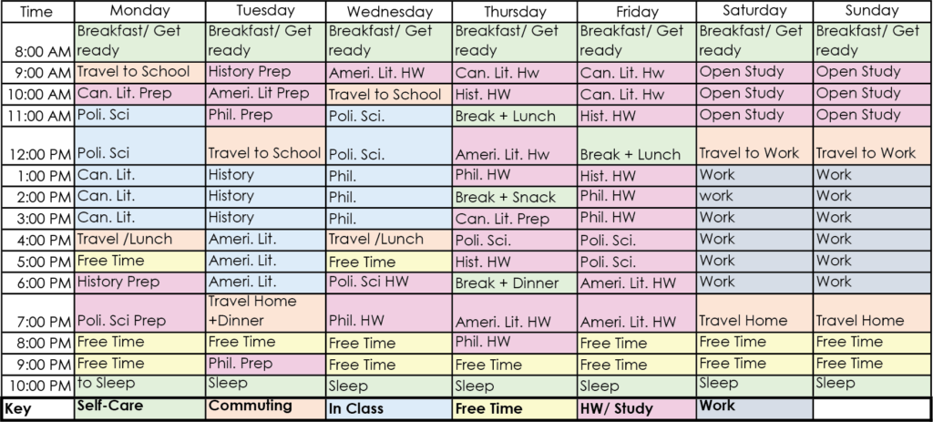
Set concrete benchmarks to monitor progress and motivate to completion
Devise a self-supervised daily and weekly personal timetables. Develop back-up plans to prepare for potential problems
Be realistic!
Time management training:
On this website there are 10 suggestions for better time management.
https://fieldreport.caes.uga.edu/publications/C1042/time-management-10-strategies-for-better-time-management/
This Photo by Unknown Author is licensed under CC BY-SA

Slide 17

Based on the free writing exercise, establish what my desired future is
Evaluate the degree to which I am committed to achievement.
Notes:
The example goal is far fetched and therefore would not impact their independent thoughts

Slide 18
References
Morisano, D., Hirsh, J. B., Peterson, J. B., Pihl, R. O., & Shore, B. M. (2010). Setting, elaborating, and reflecting on personal goals improves academic performance. Journal of applied psychology, 95(2), 255.
Robbins, S. B., Lauver, K., Le, H., Davis, D., Langley, R., & Carlstrom, A. (2004). Do Psychosocial and Study Skill Factors Predict College Outcomes? A Meta-Analysis. Psychological Bulletin, 130(2), 261–288. https://doi.org/10.1037/0033-2909.130.2.261

